Slide 1
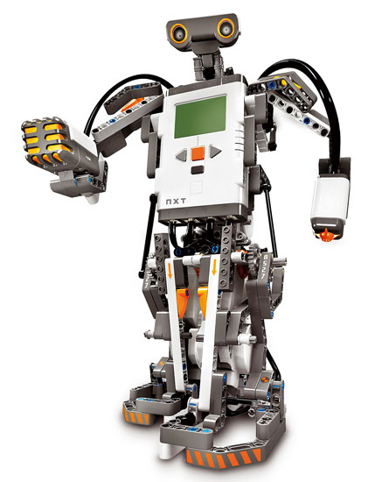
Gr8 Team
Meeting #3
Week 2

Slide 2
Gantt Chart

Slide 3
Budget review
Meeting 1:
What needs to be done for this week
Checked the design
Strategy (attacker/defender)
Meeting 2:
Testing plans
Issues with out robot
How can we modify the design
See “Initial week 2 planning” excel file

Slide 4
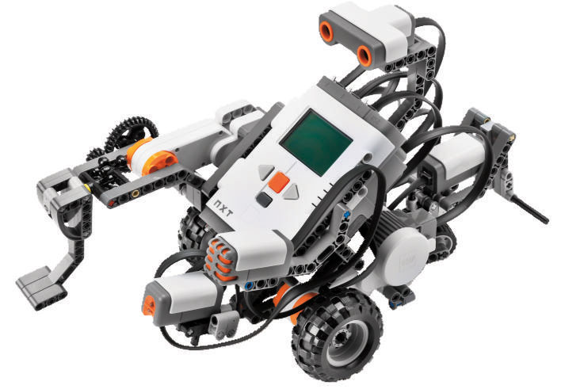
Weekly time budget
Names |  |  | Week 1 | Week 2 | Week 3 | Week 4 | Total
Ammad Usman |  |  | 5 |  |  |  | 5
Baran Ureten |  |  | 7 | 8.5 |  |  | 15.5
Chowdhury Abir Hassan |  |  | 6.5 | 7 |  |  | 13.5
Andrew Walker |  |  | 5 | 6 |  |  | 11
Maxime Grégoire |  |  | 5 |  |  |  | 5
Dan Crisan |  |  | 6.5 | 9 |  |  | 15.5
 |  | Total/week (hours) | 35 | 30.5 | 0 | 0 | 65.5

Slide 5
Time distribution
Time distribution |  | Week 1 | Week 2 | Week 3 | Week 4 | Total
Discussions and management |  | 7.5 |  |  |  | 7.5
Design |  | 8 |  |  |  | 8
Programming/Testing |  | 5 |  |  |  | 5
Documentation |  | 5 |  |  |  | 5
 | Total (hours) | 25.5 | 0 | 0 | 0 | 25.5

Slide 6
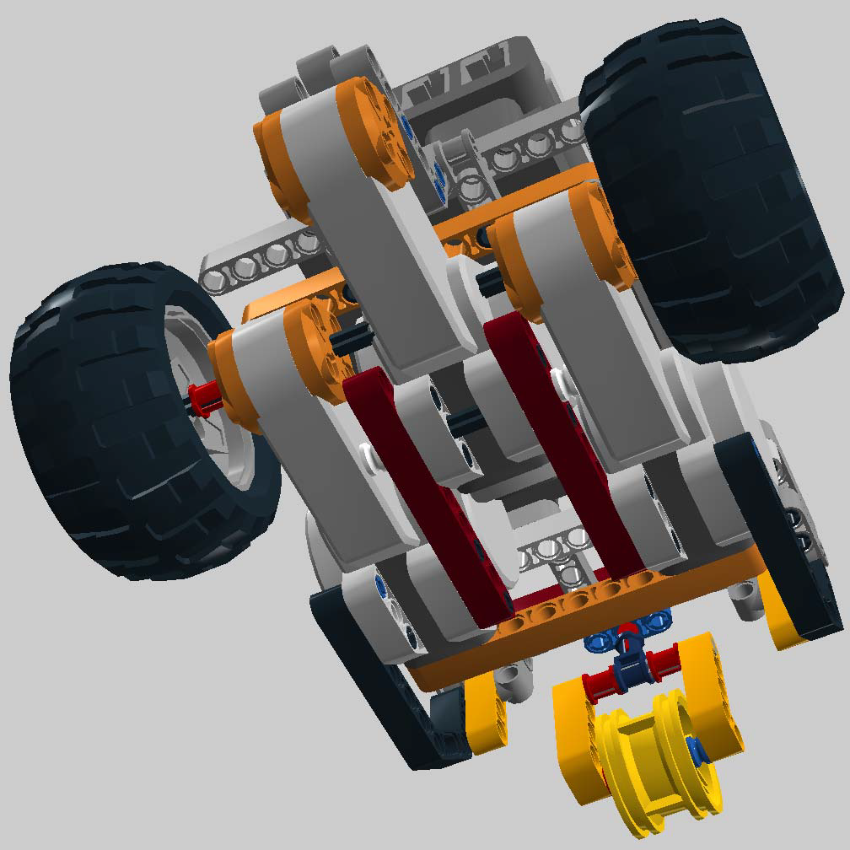
Completion of the CAD (LDD) model
A few concerns regarding the 150g 500g…
Stability (wheels)
Arm redesign? (shorter… less motors?)
Claw redesign

Slide 7
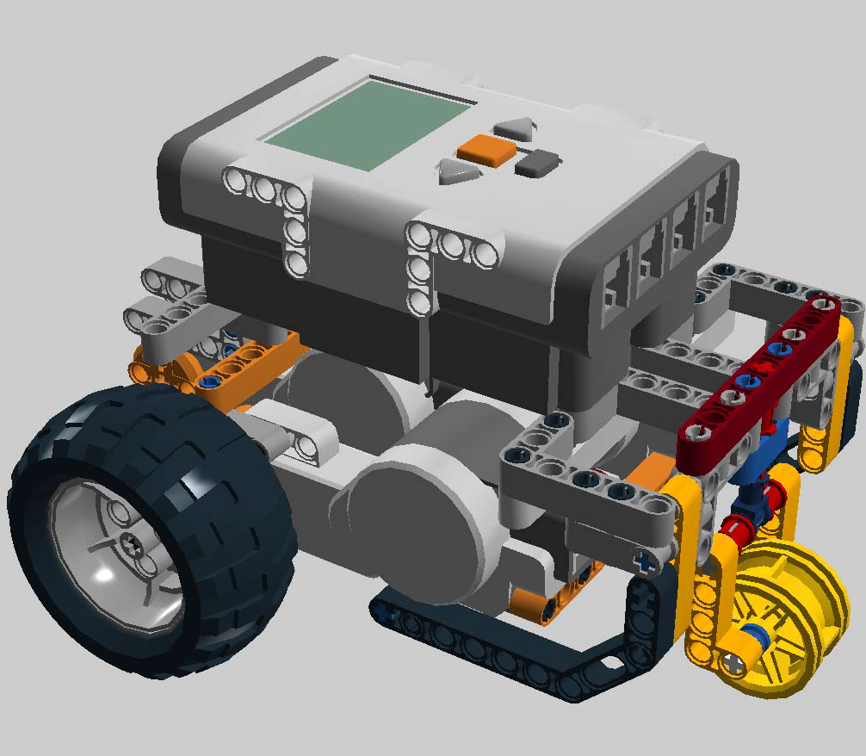
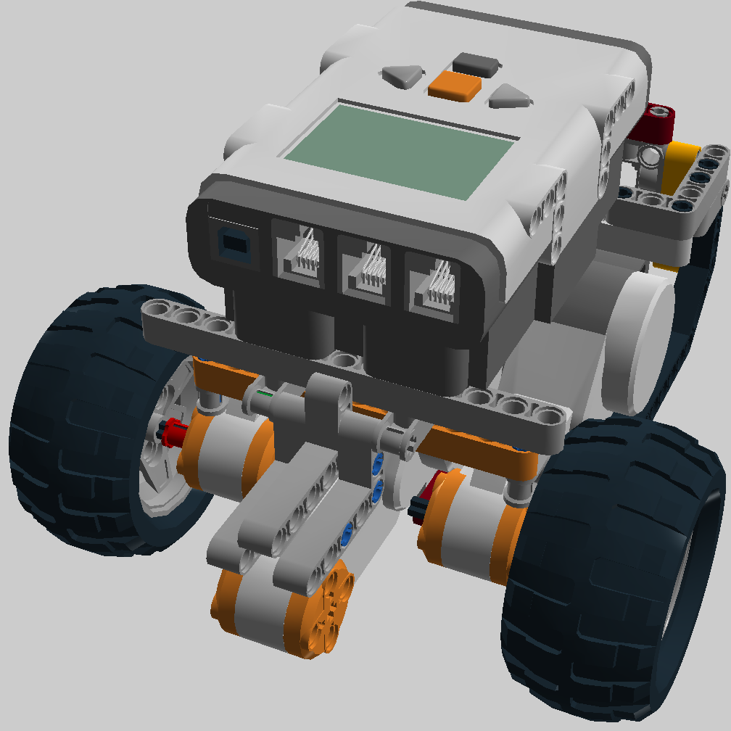
Completion of the CAD (LDD) model
Arm redesign ?

Slide 8
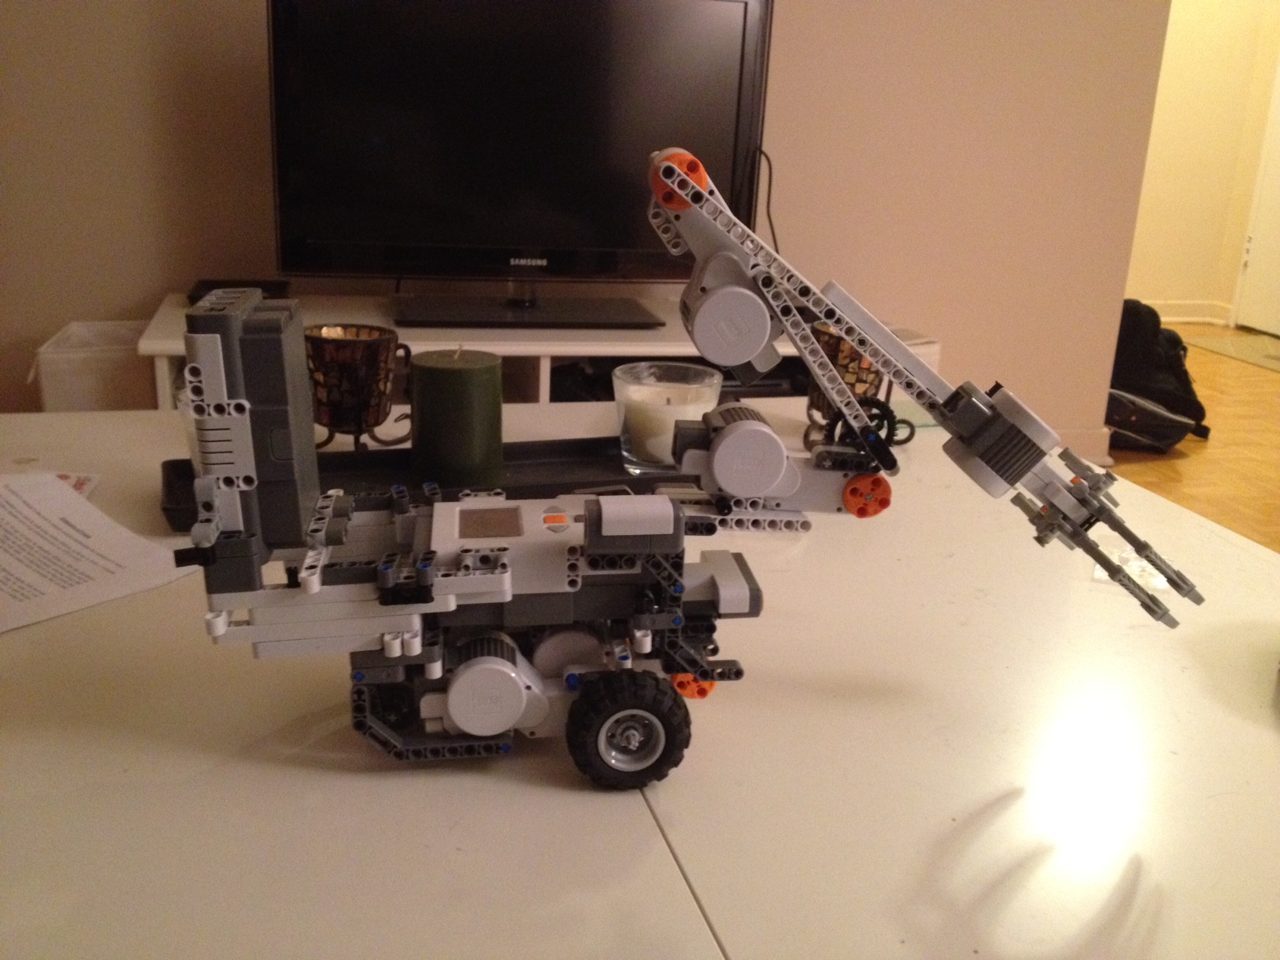

Slide 9
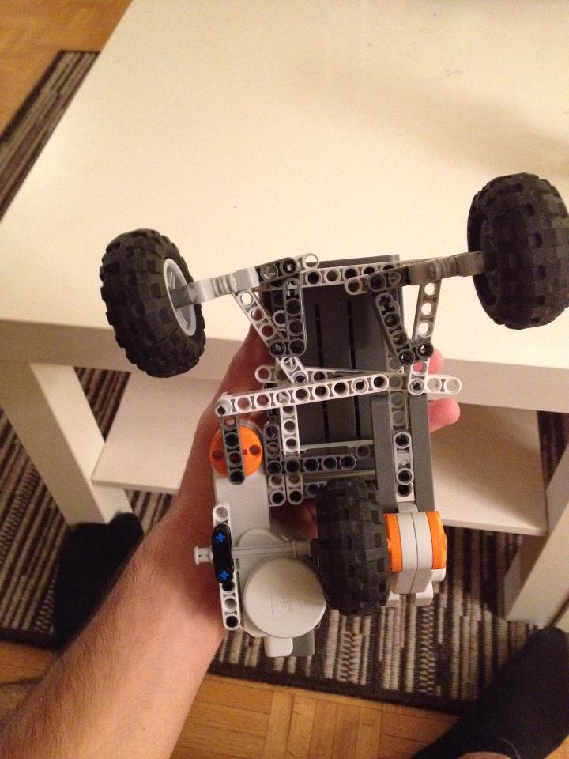
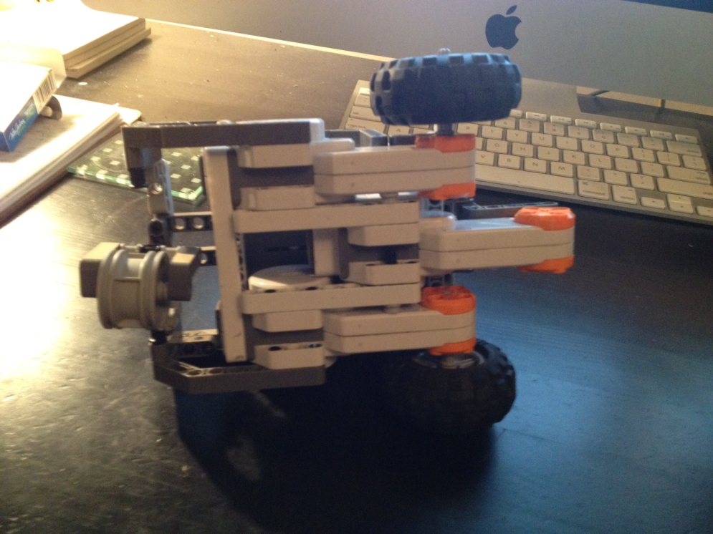
What’s new
2 LightSensors (one at top, one at bottom)
Fixed the arm
Fixed the base (more stable and easier for the odometer)
VS

Slide 10
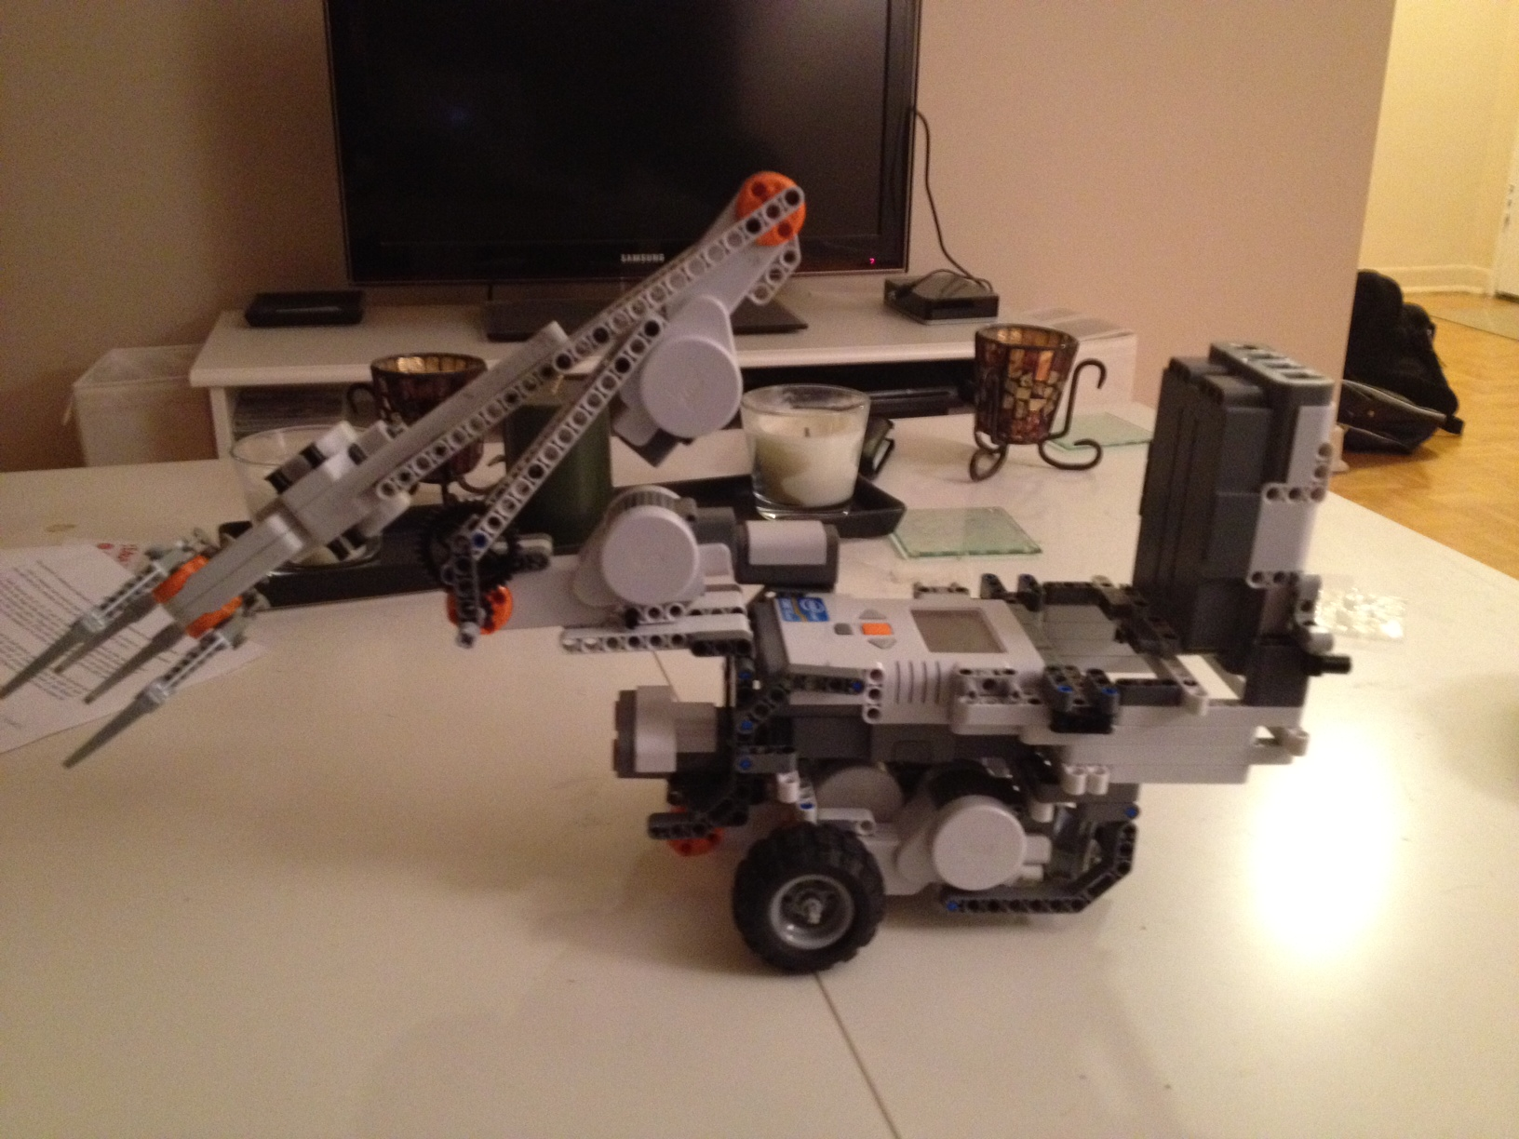

Slide 11
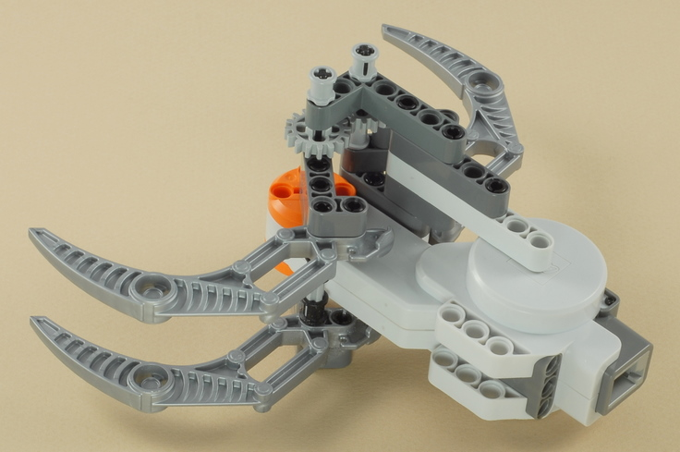
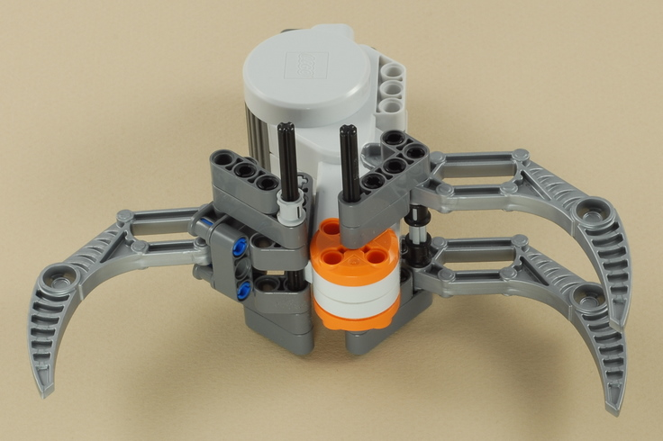
Completion of the CAD (LDD) model
claw redesign

Slide 12
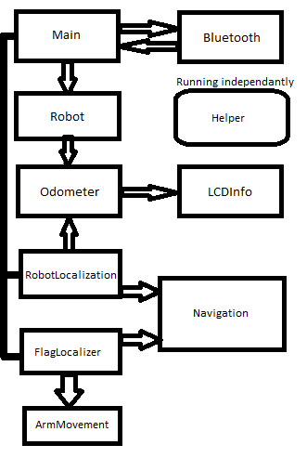
Status of software development
System model
All actual code is on
DropBox

Slide 13
Presentation of complete testing plan
See “Test document” file

Slide 14
Presentation of complete testing plan
See “Test document” file

Slide 15
Strategy
Attacker:
If LS is at the top, best case : scan it from the initial point and only avoid obstacles.
If not, cover the most possible space in the less possible time(while looking for the LS)
Defender:
Locate an obstacle
Hide the LS behind it
Either block robot’s path or
Robot blocks access to LS from one side, obstacle blocks it from the other… arm blocks one side (hehehe)

Slide 16

Questions
Can we place LS at the top of the other robot?
Are we allowed to pass sideways?
Are we allowed to move obstacles?
What is the demo about?
When is the poster due for?
Others…

